Slide 1
Eliminating technical debt in Digital Humanities projects
Janelle Jenstad and Martin Holmes University of Victoria Humanities Computing and Media Centre

Slide 2
Outline
Who we are and what we do
What we used to do 20+ years ago
The advent of exciting new tools
Problems with the new approach:
Sporadic/partial publication with missing dependencies
Uncitability
Maintenance burden and security risks (Tamagotchi projects)
We were thinking like software devs. How about thinking like humanists?
How book editions have worked for centuries (Speculum pecatris)
How can we use this model for digital editions? (Pet rock projects)
Endings principles.
Everything we gain.

Slide 3
What is HCMC?
Set up in the mid-1990s​
Provides programming support for research and teaching in the Humanities​
Has published hundreds of digital resources over the years​
Many of these are large-scale digital editions, such as:​
The Map of Early Modern London (13,257 pages, mapoflondon.uvic.ca)​
The Colonial Despatches of BC and Vancouver Island (10,827 pages, bcgenesis.uvic.ca)​
The Landscapes of Injustice Archive (154,846 pages, loi.uvic.ca/archive)​

Slide 4
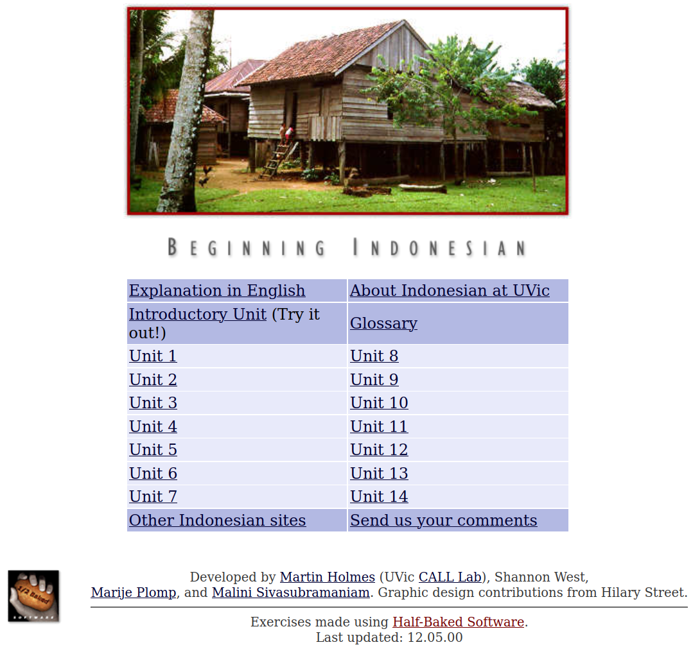
The 1990s
We made websites mostly to support language teaching.​
We build lots of interactive exercises using HTML, CSS and JavaScript.​
Most of these sites have never been updated – see for example:​
web.uvic.ca/hrd/indonesian/​

Slide 5
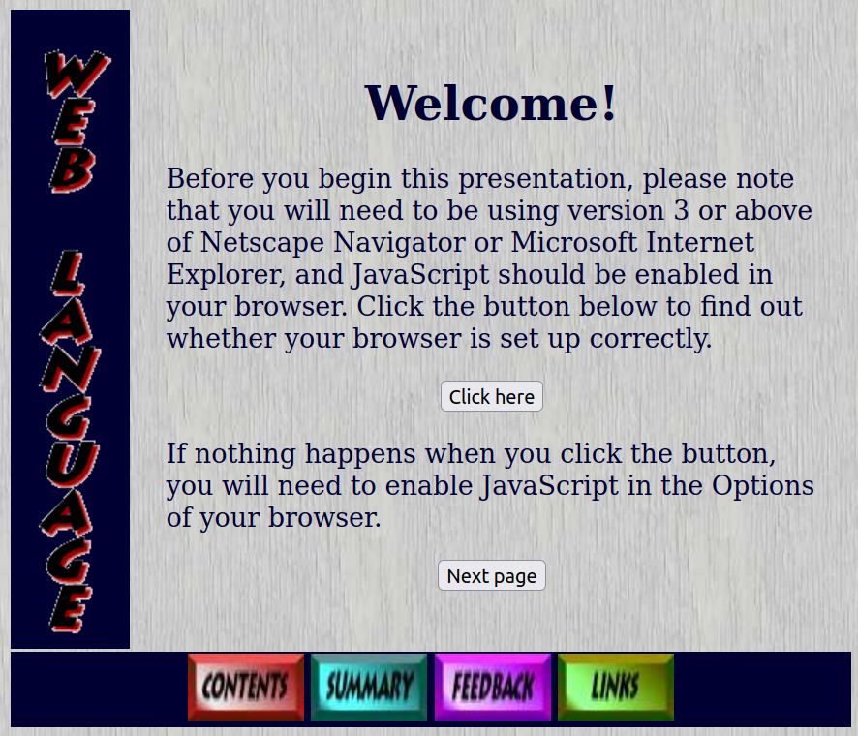
The 1990s
These sites all still work – even though they look SOOO 1990s:​
web.uvic.ca/lancenrd/martin/weblang/
No maintenance burden from these sites!

Slide 6
The early 2000s
Digital Humanities became a thing.
New technologies came along.
We got ambitious and enthusiastic, and started building larger, more complex sites with:
ASP
MySQL, PostgreSQL, PHP
Apache Cocoon
The eXist XML database
...and lots of other cool new tools.​

Slide 7
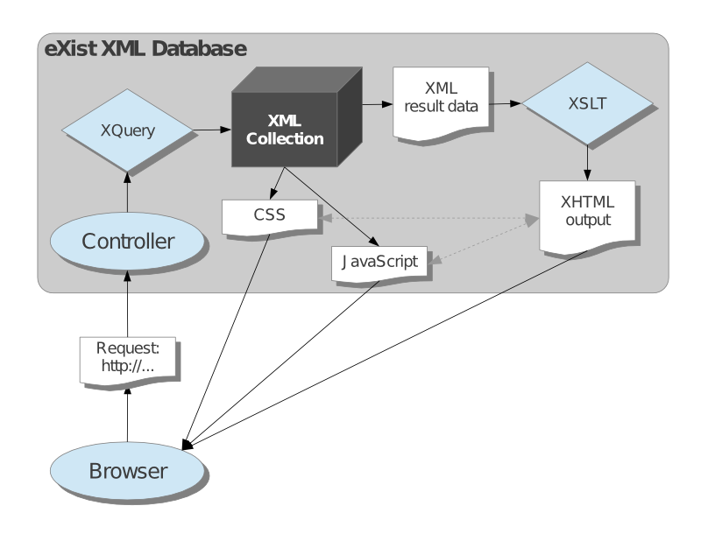

Slide 8
Apparent advantages of this sort of stack
​Changes to output rendering propagate instantly to the whole collection.
Individual documents can be published as soon as they’re ready (“rolling publication”).

Slide 9
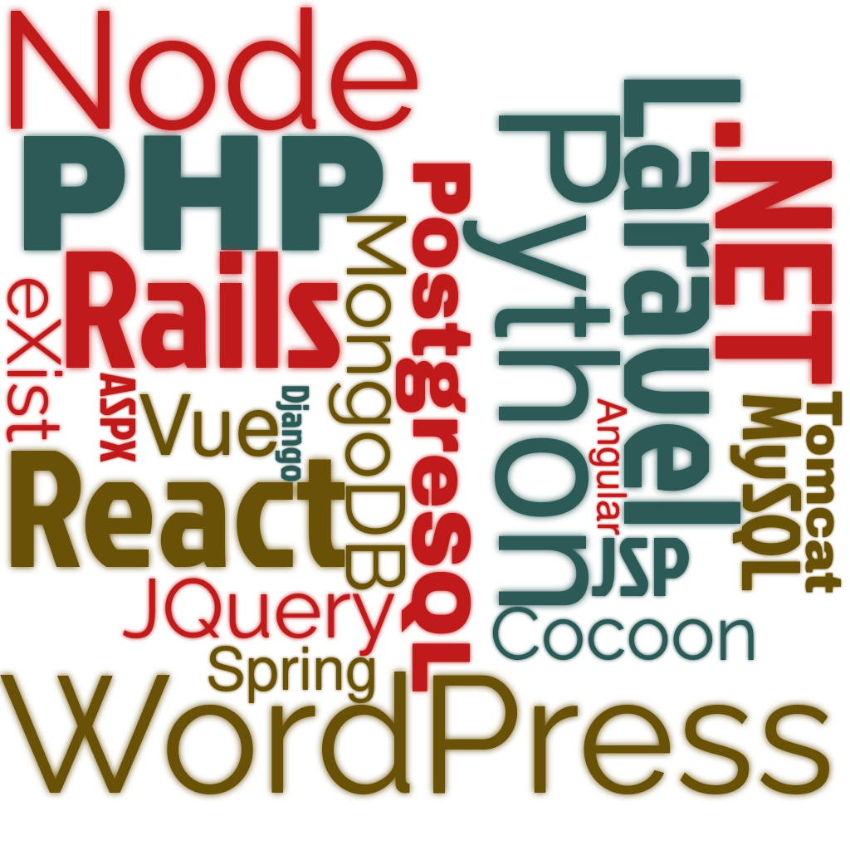
BUT: Horrible technical debt

Slide 10

BUT: Horrible technical debt
Update Java: Tomcat breaks.
Update Tomcat: Cocoon breaks.
Update Cocoon: eXist breaks.
Update eXist: XQuery has to be
rewritten.
...
OS update requires MySQL update.
MySQL update requires PHP update.
PHP update requires code rewrite.
...

Slide 11

Now every project is a Tamagotchi.
Life is nothing but maintenance.
There’s no time for new projects.

Slide 12
But wait – it’s worse. Remember this?
Individual documents can be published as soon as they’re ready (“rolling publication”).
It seemed like a good idea at the time...

Slide 13
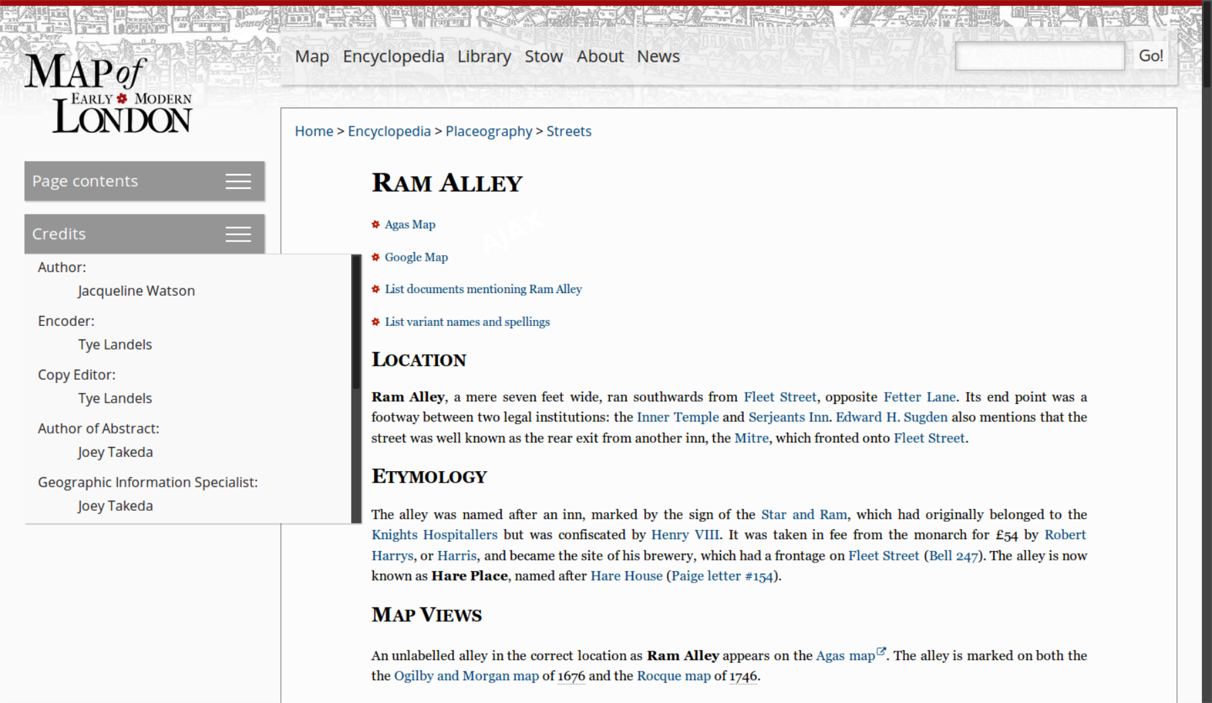
The trouble is, there’s no such thing as a document.

Slide 14
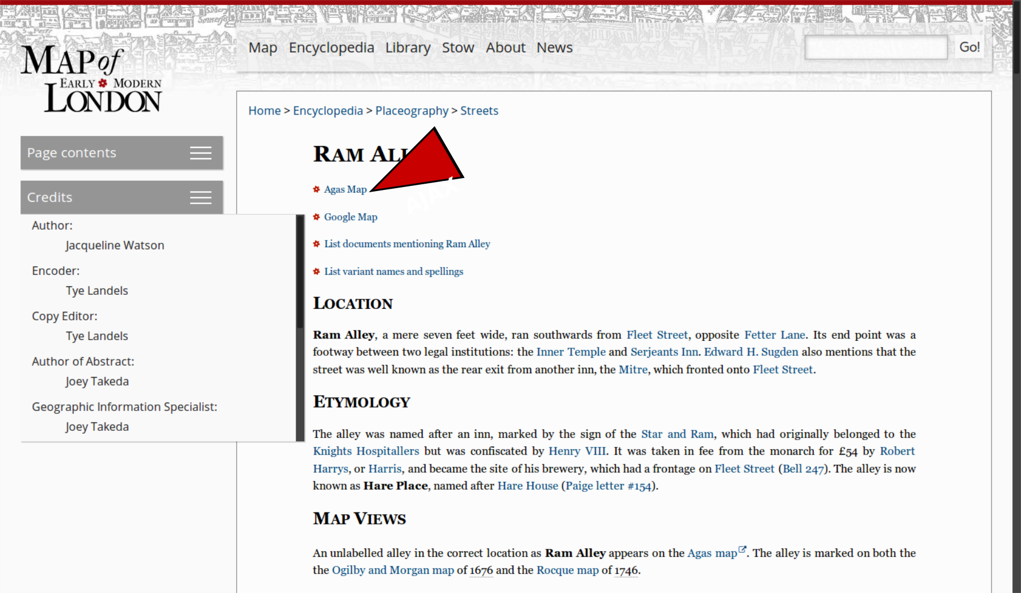
The trouble is, there’s no such thing as a document.

Slide 15
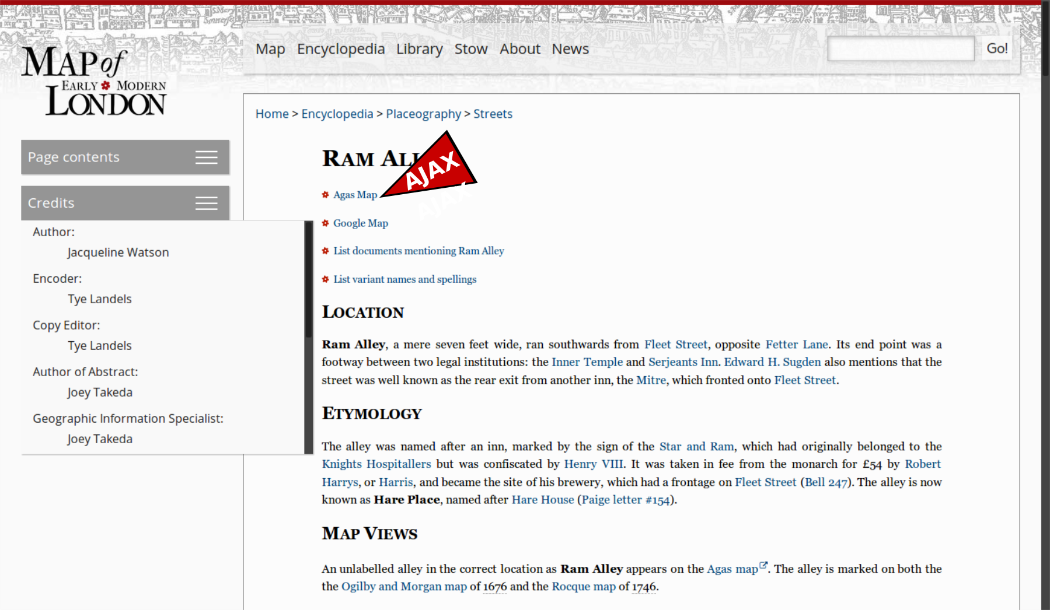
The trouble is, there’s no such thing as a document.

Slide 16
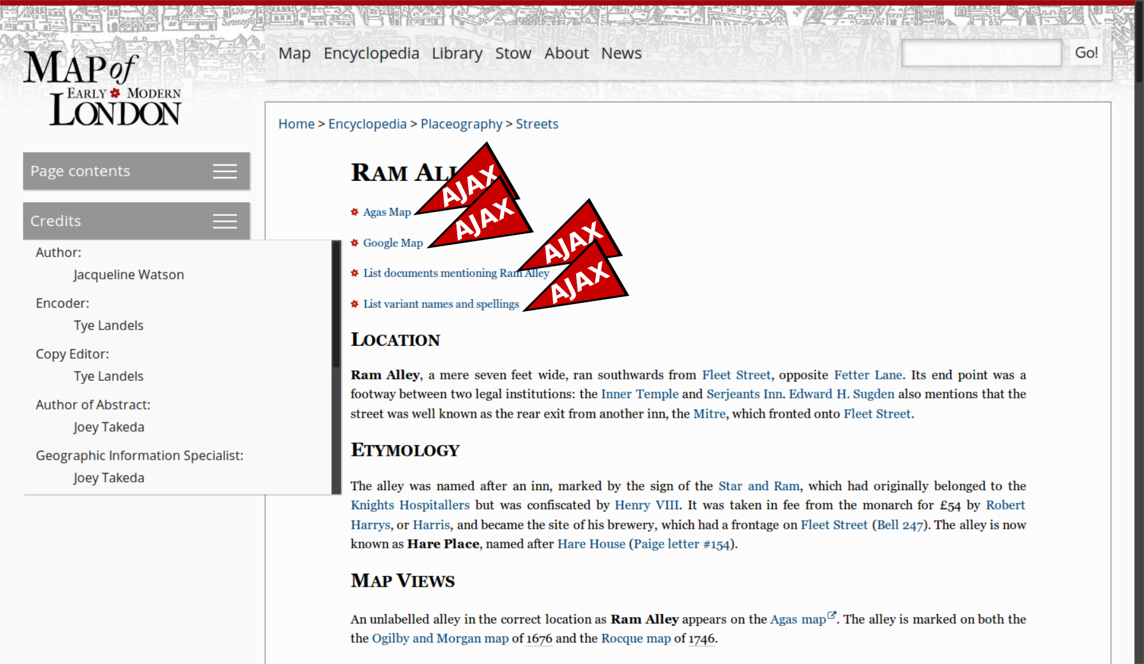
The trouble is, there’s no such thing as a document.

Slide 17
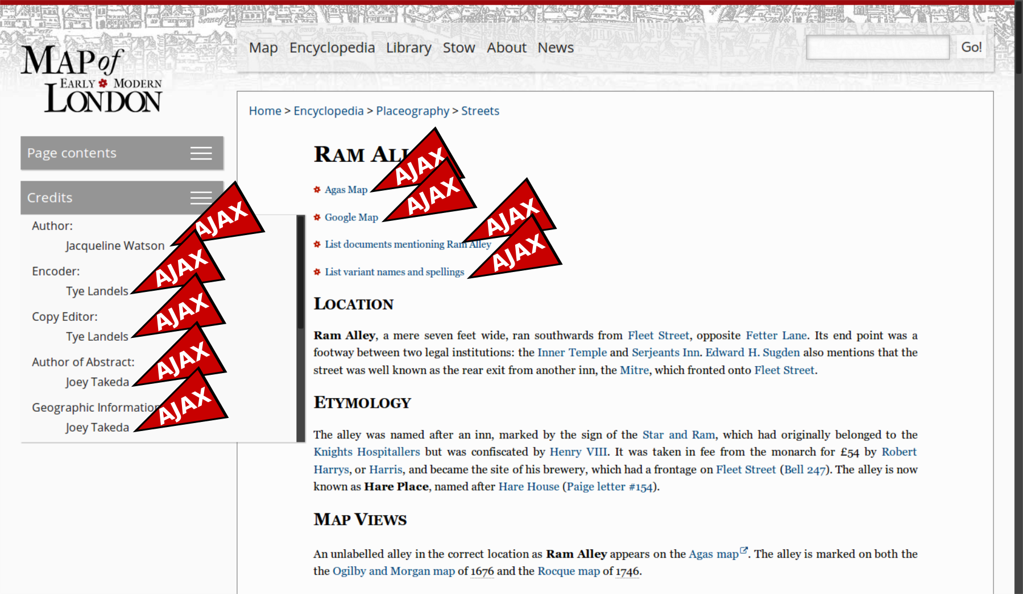
The trouble is, there’s no such thing as a document.

Slide 18
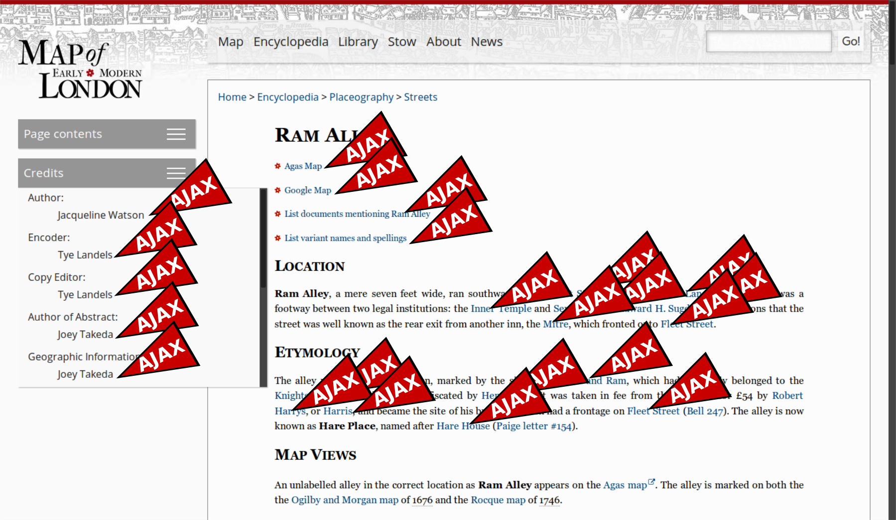
The trouble is, there’s no such thing as a document.

Slide 19
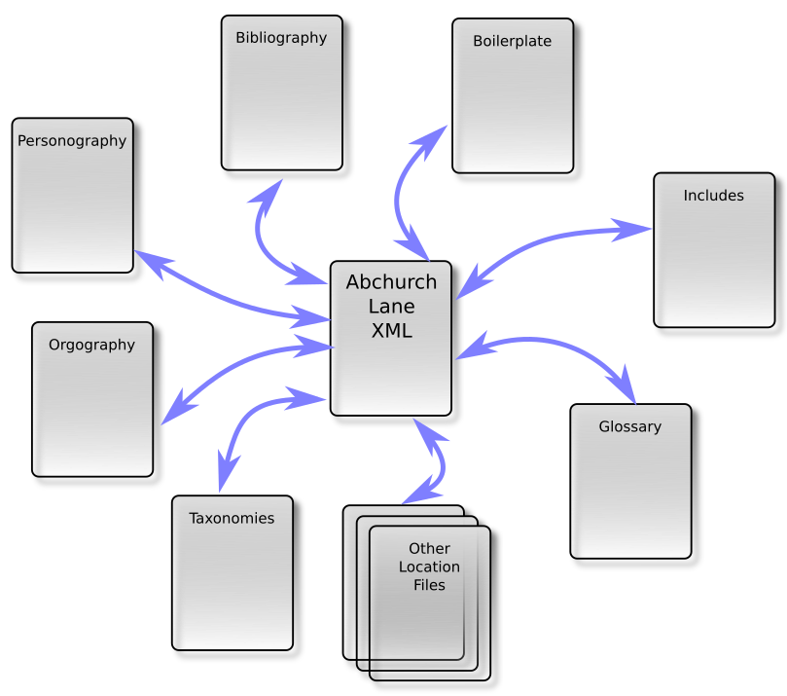
A digital edition is a network, not a collection of discrete docs

Slide 20
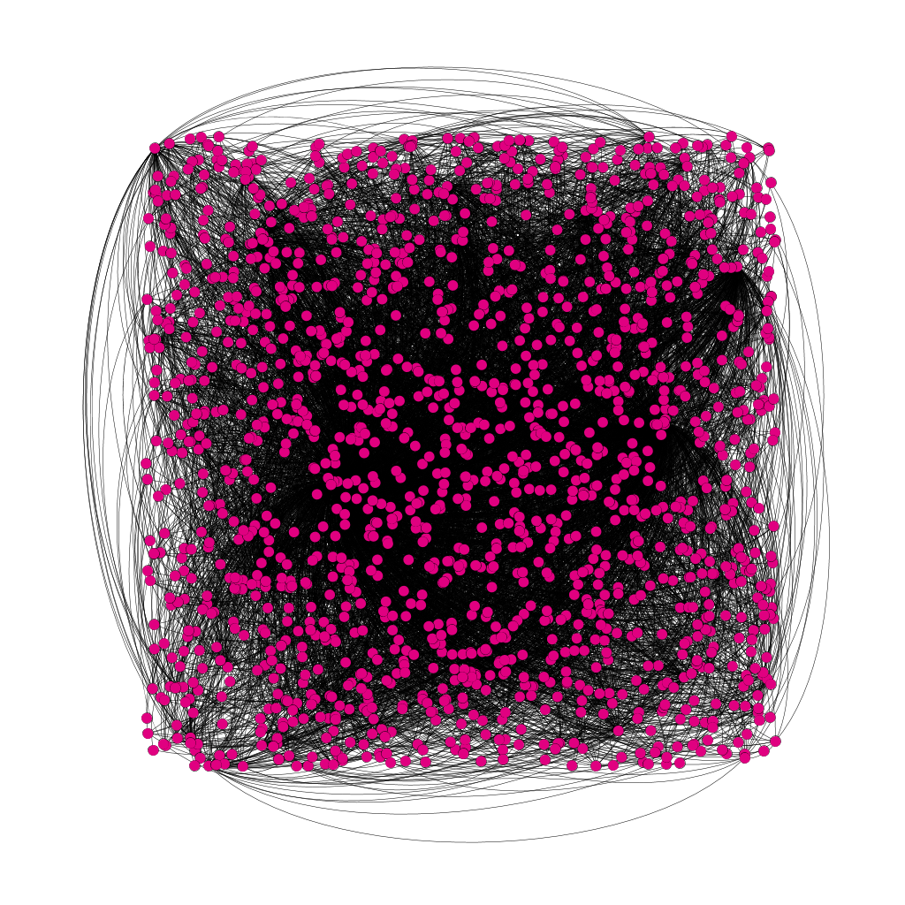
Network map of MoEML

Slide 21
The scholarly corollary:
​Changes to one “document” cause changes to other “documents”.
There is no reliable way to cite a “page”.
There’s no way to get back to the version of a “page” you saw last week.
So nobody will cite the project.
So the scholars involved will not win prizes/get tenure/get grant money/be happy and successful.

Slide 22
So the rolling-release technical-debt model is:
​bad for developers because they spend their lives on maintenance; and
bad for scholars because their work appears untrustworthy and uncitable.
So let’s stop thinking like software developers, and start thinking like proper humanists.

Slide 23
What the Book Got Right, or, Lots Of Static Copies Keep Stuff Safe
Martin Holmes, Janelle Jenstad,
and the Endings Team

Slide 24
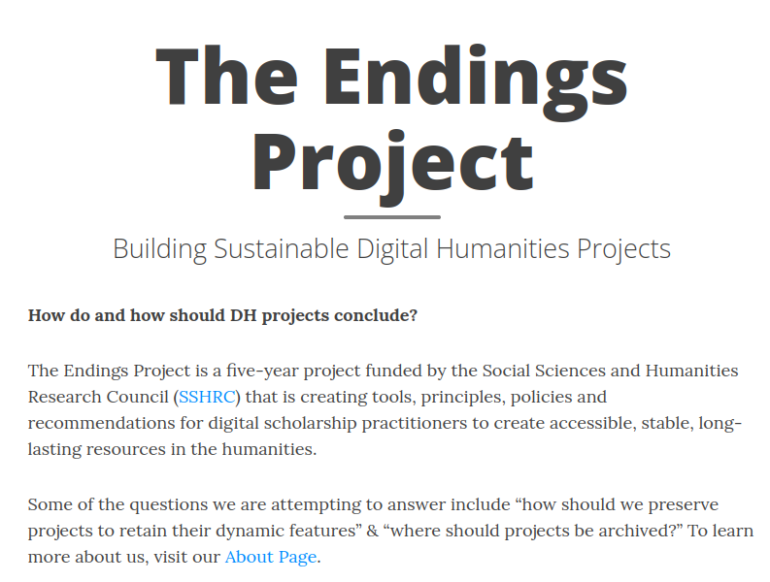
Introduction
Notes:
Our work is part of a larger SSHRC-funded project, namely The Endings Project: [[fullname]]. We are a group of three developers, three humanist researchers, and three librarians who are working to find ….

Slide 25
Outline
1. Edition Versioning
2. Software Versioning
3. “Rolling-Release” Model
4. Justifiable Suspicions of Moving Targets
5. Stable Editioning
6. Lots of Static Copies
7. Conclusions
Notes:
The attractive prospect of instant, effortless publication and updating has enchanted digital humanists; it is now the norm for digital editions to be presented in constantly-changing versions. However, this publication model has profound scholarly drawbacks. We advocate for a return to the book-like edition model of publication, on the grounds that the edition has stood the test of time as a distribution and archiving medium. Our paper today traces the history and origin of the concept of “edition” from its inception in the early days of handpress printing to modern patterns of print editions and the tension between marketing and textual stability. My developer colleague, Martin Holmes, will then turn to the history of software versioning as …. Into the versioning model comes ….

Slide 26
Edition Versioning

Slide 27
Edition
German Edition (1537)
Dutch editie (1546)
English edition (1556)
Italian edizione (1575)
Portuguese edição (1666)
Notes:
Print culture makes it possible to create multiple copies of a text, with the expectation that the copies will be fundamentally the same thing. This is what the notion of an edition tries to capture.

Slide 28
“edition”
Edmund Coote, The English Schoolmaster (1596): “putting forth”
John Florio, A World of Words (1598): “a setting foorth, a publishing, a creating or an edition”
Robert Cawdrey, A Table Alphabetical (1604): a “putting fourth, setting abroade”

Slide 29
Edition as text
A printed version of a given work that may be distinguished from other versions … by its membership of a complete batch of copies printed from the same setting of type, usually at the same time and place. These batches come to be numbered as first, second, third, etc. editions, each time a new version is set again from fresh type.
- Baldick, Oxford Dictionary of Literary Terms

Slide 30
New Edition as New Text
I haue now in this seconde edition taken about it such paines, yt verye fewe great faultes & notable errours are in it to be founde.
– Ralphe Robynson,
second edition of
his translation of
Thomas More’s Utopia, 1556 (A3v)

Slide 31
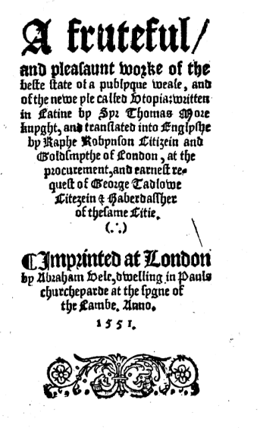
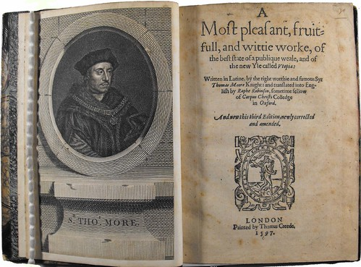
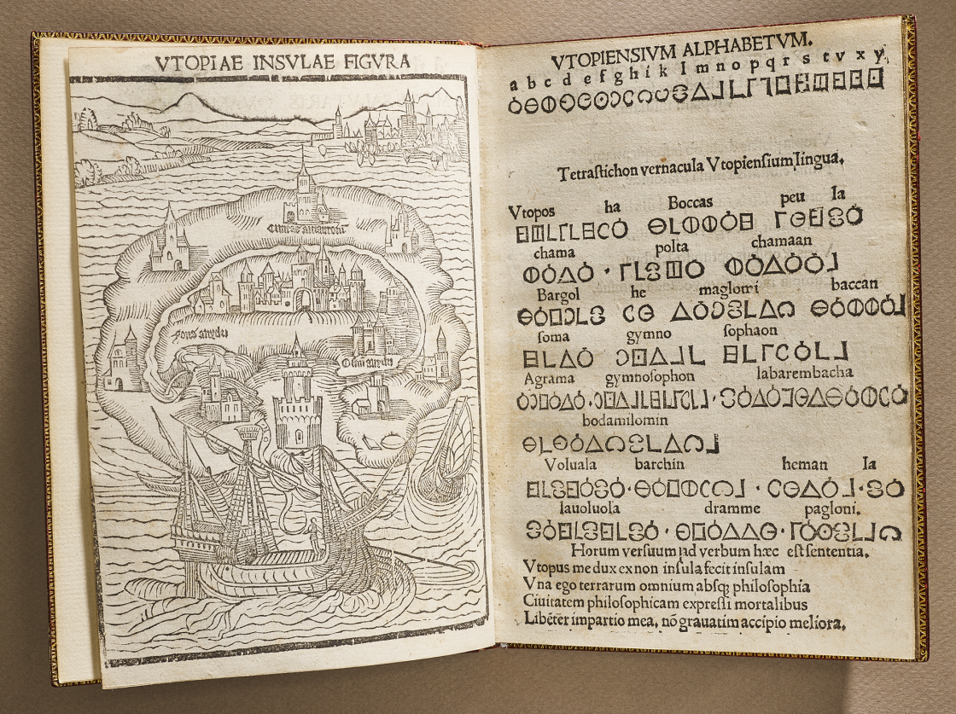
Notes:
1516 (NYPL), 1551, 1556

Slide 32
Edition as format
A printed version of a given work that may be distinguished from other versions … by its published format (e.g. paperback edition, popular edition, abridged edition)
– Baldick, Oxford Dictionary of Literary Terms

Slide 33
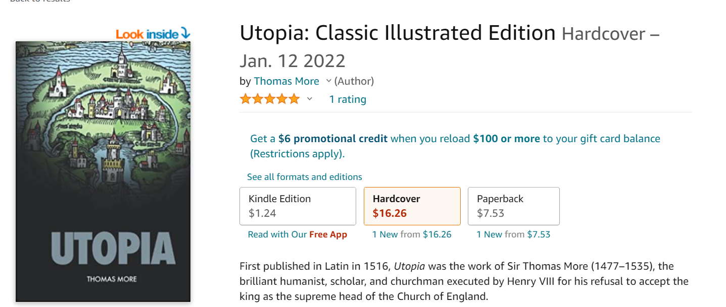
Examples
Paperback edition
Hardcover edition
Kindle edition
Audiobook edition
Classic illustrated edition (available in Kindle edition)

Slide 34
Edition as Textual Critical Production
The term is also applied rather differently to the works of an author as edited by a particular scholar or by a team of scholars sharing the same procedures.
– Baldick, Oxford Dictionary of Literary Terms

Slide 35
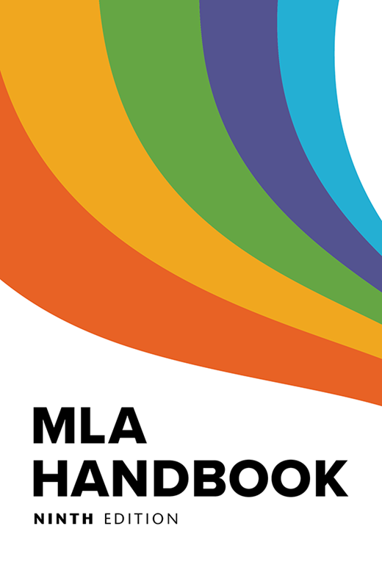
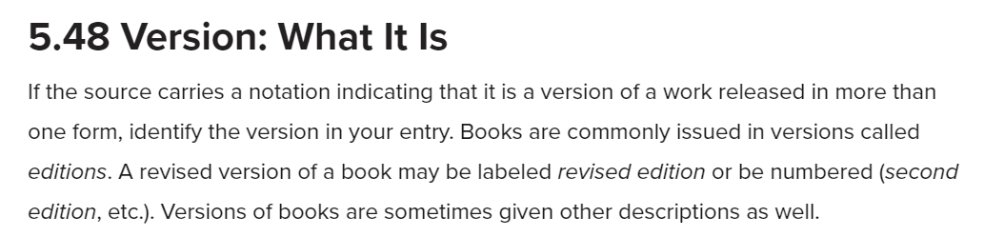
Convergence of Editions and Versions
Notes:
Hand over to Martin at the end of this slide.

Slide 36
“... software versioning is a rich signifying practice, and it offers a model that suggests practical solutions for editors of digital editions.”
– Paul Broyles, “Digital Editions and Version Numbering”

Slide 37
Software versioning
Notes:
Martin starts. Needs 7.5-8 minutes.

Slide 38
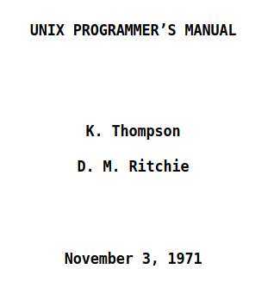
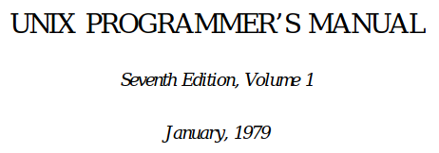
Early UNIX “versions” were actually the editions of the UNIX manual

Slide 39
Early software such as the FORTRAN compiler used numeric versions…
First compiler (1957)
FORTRAN II (1958)
FORTRAN III (1958 but never released)
FORTRAN IV (1962)

Slide 40
But then Marketing got involved…
First compiler (1957)
FORTRAN II (1958)
FORTRAN III (1958 but never released)
FORTRAN IV (1962)
FORTRAN 66 (1966) 😟

Slide 41
So we get:
Windows 1.0
Windows 2.0
Windows 3.0
Windows 3.1
Windows 95
Windows 98
Windows 2000
Windows ME
Windows XP
Windows VISTA
Windows 7
Windows 8…

Slide 42
But behind the scenes…
The original and current version of Windows 11 (also known as version 21H2) was released in October 2021.^{[1][2]} It carries the build number 10.0.22000.
-https://en.wikipedia.org/wiki/Windows_11_version_history

Slide 43
So nowadays, software versioning is relatively well understood and implemented
…if we ignore marketing labels and know where to look to find the truth.
Most software incorporates detailed version information into its build process so that it’s easy to discover, and this version information usually includes the exact state of the source code files which are compiled to create the software.

Slide 44
Ultimately, Semantic Versioning emerges
major.minor.patch.build.tag
This is a standard which itself is versioned (currently 2.0):
https://semver.org/

Slide 45
But then came:
Web pages
Web sites
Blogs
Digital editions
Content-management systems
(not to mention Facebook, Twitter, Instagram and all that ….)

Slide 46
“Rolling Release” Model

Slide 47
Features of web resources
Instant publication
Change/fix/revise/upload any time
“Rolling release”
All wikis (including Wikipedia) work on the rolling release model.

Slide 48
Corollaries of these features
Constantly-mutating pages
No reliable way to cite
No easy way to retrieve the version you cited from last week

Slide 49
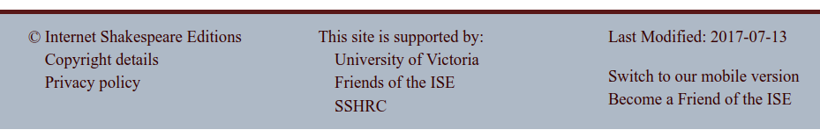
But what about “Last modified” dates?
Notes:
Actually modified 2018-12.

Slide 50
The trouble is, there’s no such thing as a document.

Slide 51
The trouble is, there’s no such thing as a document.

Slide 52
A site is a network, not a collection of discrete docs

Slide 53
Network map of MoEML

Slide 54
What does this mean?
Any part of a “page” may change without the “page” being “modified”.
Different components of an “edition” change at different times, out of sync.
You have no idea what you’re citing, when it last changed, or who was responsible for it.
Notes:
Hand over to JJ.

Slide 55
Justifiable Suspicion of Moving Targets
Notes:
JJ taking over. Notes for this section: The internet and the "rolling-release" chaos, citation issues, stability problems, justifiable suspicion & unwillingness to cite online resources; no such thing as a document, so entire site must be aligned

Slide 56
… you should never end your research with Wikipedia or another wiki. Instead, use such sites at the very beginning stages of your research to gather basic information and sources and then move on to more credible sources.
– Ellen C. Carillo, MLA Guide to Digital Literacy, 104
Notes:
Mention the WikiBooks edition of The Devonshire Manuscript.

Slide 57
Even Wikipedia won’t cite Wikipedia
Wikipedia is not a reliable source for citations elsewhere on Wikipedia. As a user-generated source, it can be edited by anyone at any time, and any information it contains at a particular time could be vandalism, a work in progress, or simply incorrect.
https://en.wikipedia.org/wiki/Wikipedia:Wikipedia_is_not_a_reliable_source

Slide 58
We claim …
Style guides won’t help us cite a moving target.
The onus is on producers of resources, not citers of resources.
The digital resources themselves need to move to stable versioning/editioning.

Slide 59
Stable Editioning

Slide 60
Endings Principles 5: Release Management
Release management handles the public release of products. Without good release management, a project can never end gracefully; it can only falter and die.
– https://endings.uvic.ca/principles.html#release-management

Slide 61
5.1 Releases should be periodic and carefully planned.

Slide 62
5.2 A release should only be made when the entire product set is coherent, consistent, and complete (passing all validation and diagnostic tests).
Notes:
e.g., all documents are “published,” all content is “complete”

Slide 63
5.3 Like editions of print works, each release of a web resource should be clearly identified on every page by its build date and some kind of version number.

Slide 64
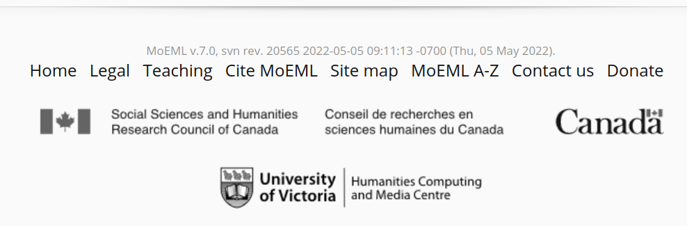
How MoEML does it
MoEML footer:

Slide 65
MoEML v.7.0, svn rev. 20565 2022-05-05 09:11:13 -0700 (Thu, 05 May 2022).
Notes:
svn rev = “same setting of type”?

Slide 66
5.4 Web resources should include detailed instructions for citation, so that end-users can unambiguously cite a specific page from a specific edition.

Slide 67
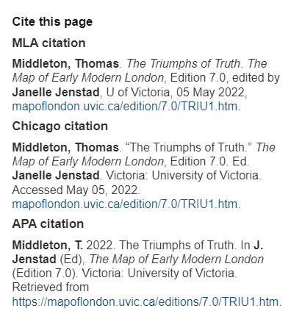

Slide 68
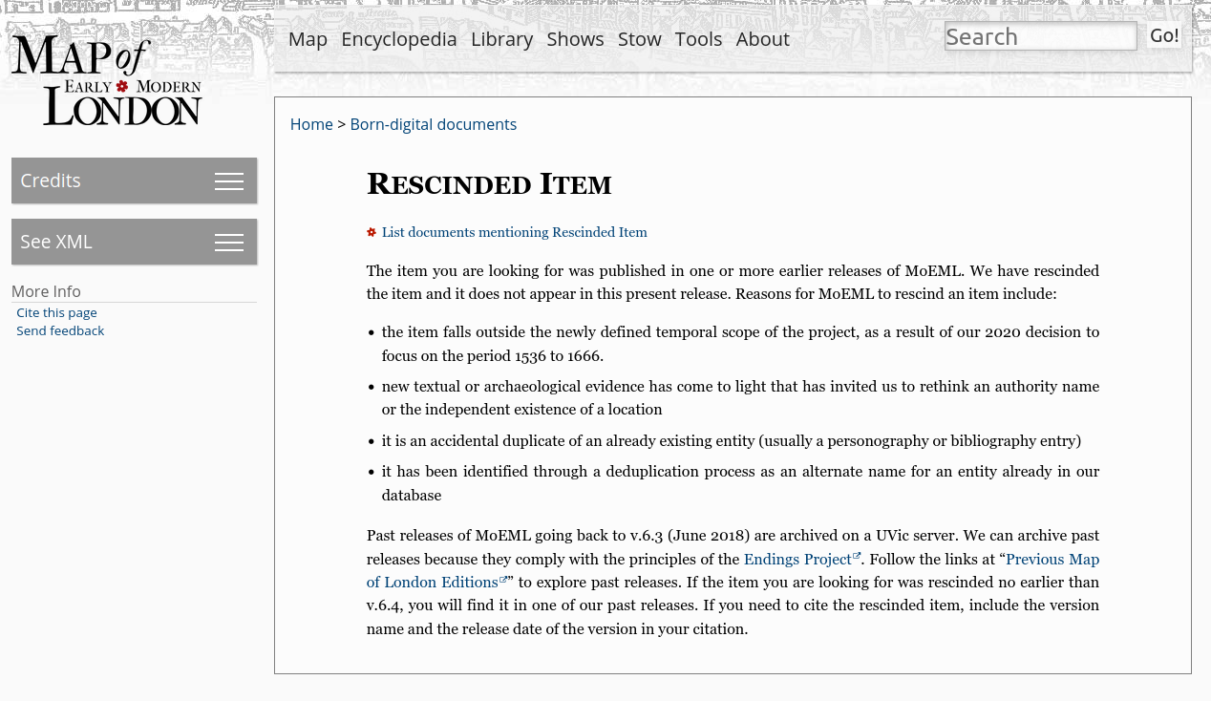
5.5 URLs for individual resources within a digital publication should persist across editions. Any moved, retired, or deleted resources no longer available at a previously accessible URL should be redirected appropriately.

Slide 69
Lots of Static Copies

Slide 70
What is a static site?
Another desirable feature of the book is its durability.
Books are durable partly because they’re multiple and scattered.
We need to do the same with a digital edition – make lots of copies.
It’s hard to make lots of copies of a complex database-driven infrastructure.
Therefore we need our digital editions to be simple, static, portable, and easily copied.

Slide 71
What is a static site?
What we release: a static, numbered edition with no server-side dependencies
HTML, JavaScript and CSS: every page is built at the same time in a single operation from a single source dataset.
You can put it on thumb drives and distribute them to run on any web server.
You can download it as a ZIP file and install it on many machines.
The copy we host at the UVic URL is the canonical copy but it’s just ONE of many static copies (like the public library copy).

Slide 72
Conclusions

Slide 73
We need to be able to cite digital editions with the same precision and reliability as print editions.
We need cited materials to persist and remain accessible.
We need to be able to archive them over the long term.
So:
We must make coherent, consistent, complete, identifiable editions, not rolling-release mutating monsters.

Slide 74
Thanks
The Endings Team: Claire Carlin, Ewa Czaykowska-Higgins, Janelle Jenstad; Stewart Arneil, Martin Holmes, Greg Newton; John Durno, Matt Huculak, Lisa Goddard; Emily Comeau and Joey Takeda
Faculty of Humanities
University of Victoria Libraries
Social Sciences and Research Council of Canada

Slide 75
Section Slide Title

